Slide 1


APPLIED PHYSICS 186 – ACTIVITY 16
MACHINE LEARNING:
Support Vector
Machine
Professor: Dr. Maricor Soriano
Instructor: Jayson Cubero
Rene L. Principe Jr.
2015-04622

Slide 2
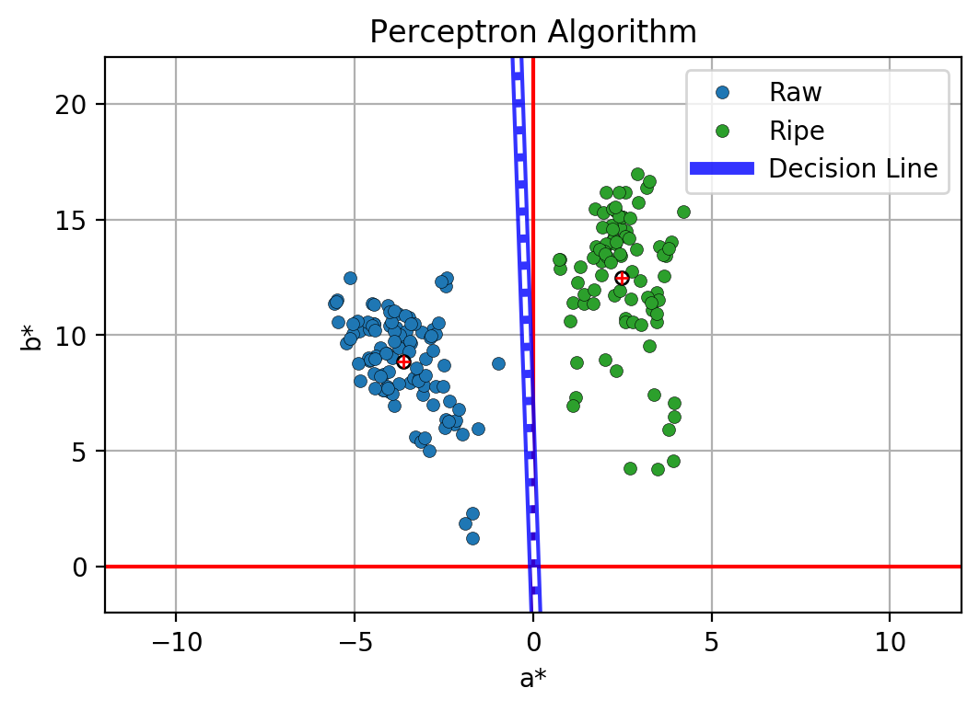
dataset
Previously, we have classified point clusters by creating a decision line solved using the perceptron algorithm. Shown in Figure 1 is a sample of classifying ripe and raw bananas according to color features a* and b*. Another way of creating a decision line is through a Support Vector Machine. Unlike the Perceptron algorithm, the decision line calculated using SVM is rest assured to be unique and the “best [1]. After, solving for the H, B and A , and vectors f, a and b, the lagrange multipliers (solution) were solved by the algorithm in [2] from which the weights were solved. The weight vector was then used to plot the decision line and the (+1) and (-1) margin to show a maximized width. Results are shown in Figure 2.
Figure 1. Color features a* and b* of raw and ripe bananas shall be used to determine a continuous ripeness variation and decision line creation using the Perceptron algorithm

Slide 3
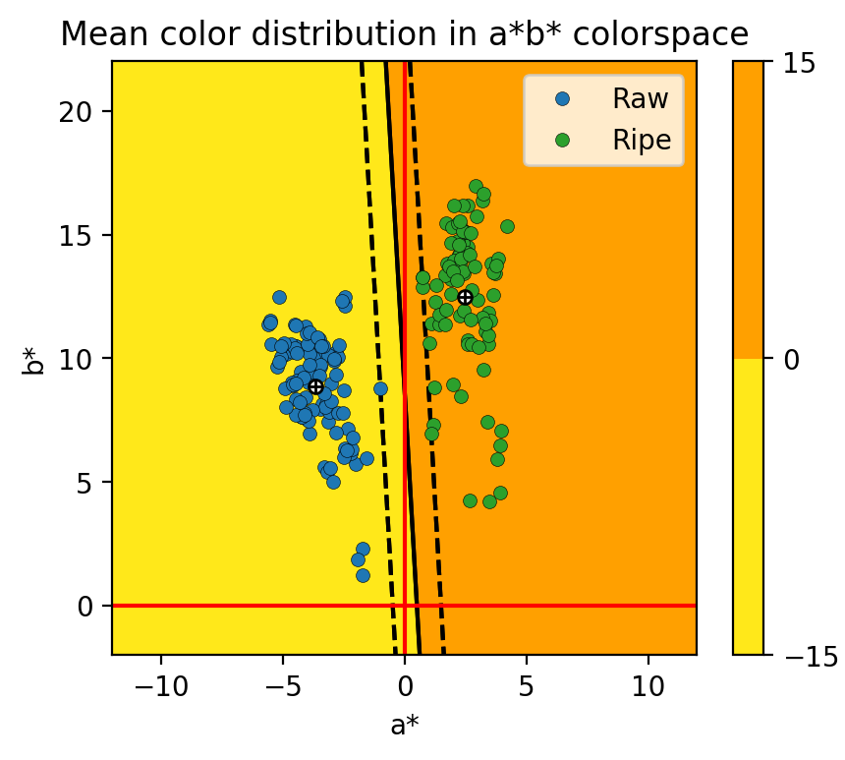
In this activity, I’d give myself a 10
For this activity, I utilized the codes shown in the references to facilitate the implementation of the SVM Algorithm.
References:
[1] M. Soriano, “Support Vector Machine”, 2019.
[2] [Codes]
https://scikit-learn.org/stable/modules/generated/sklearn.svm.SVC.html
https://stackoverflow.com/questions/23794277/extract-decision-boundary-with-scikit-learn-linear-svm
Figure 2. Decision line solved using the SVM algorithm.

